Slide 1
WORKSHOP SESSION
Vibe Coding:
From Idea to MVP
at Warp Speed
This is not a talk. You’re going to build, think, and explain.
SXSW 2026 WORKSHOP
Notes:
Welcome
A little but about this session
1 – Intro to Vibe coding – my background and Flyercopilot as a case study on how and how not to vibe code
2 – My next big idea – a few words about Event apps, dissatisfaction
3 – Part 1 – planning – laying out the structure and architecture for a complex application
4 – A group exercise – First Principle – an app has to solve someone’s problem – let’s ideate what problems we can solve using LEGO
5 – Turning thoughts into Code – a guide to prompting and how to get something built
6 – Group Exercise – prompting the next piece of the Jigsaw
7 – Turning our ideas into a Roadmap
8 – Turning roadmap into reality

Slide 2
INTRODUCTIONS
Notes:
Rich
Chris
Bobby Jo?
Me

Slide 3


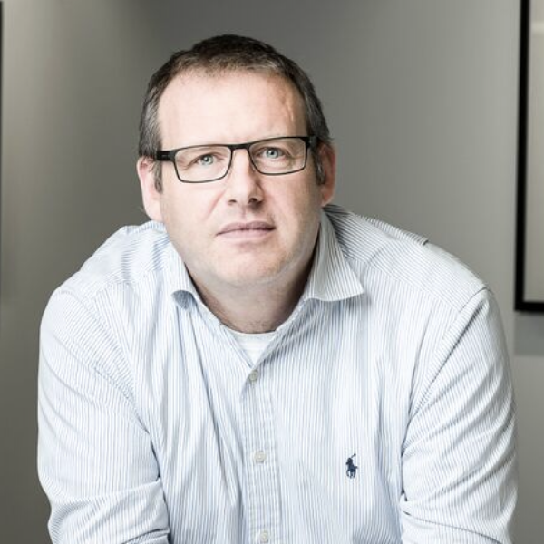



THE TEAM
Who We Are
Matthew
Steiner
Richard Bennett
Flyercopilot Founder
Maven Advisory CEO
Red Hat
Business Value Consultant
Hashicorp
EMEA CTO

Slide 4
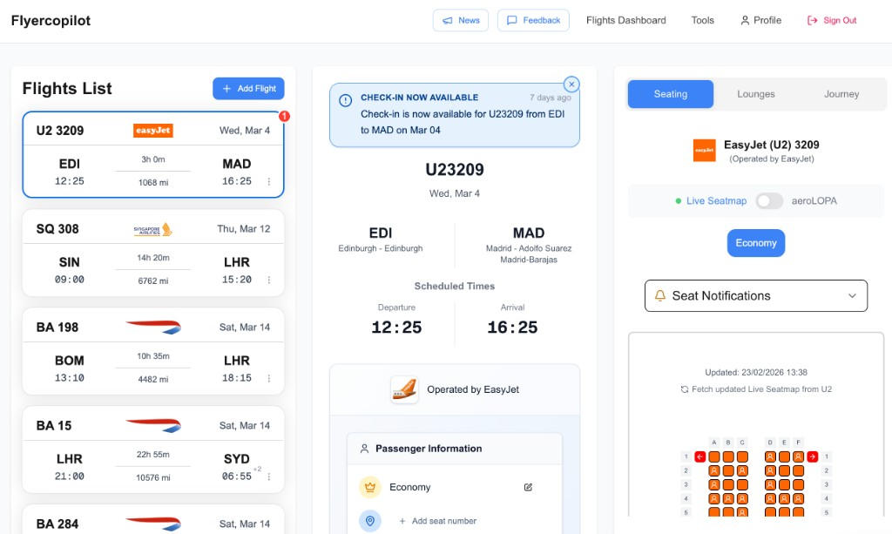
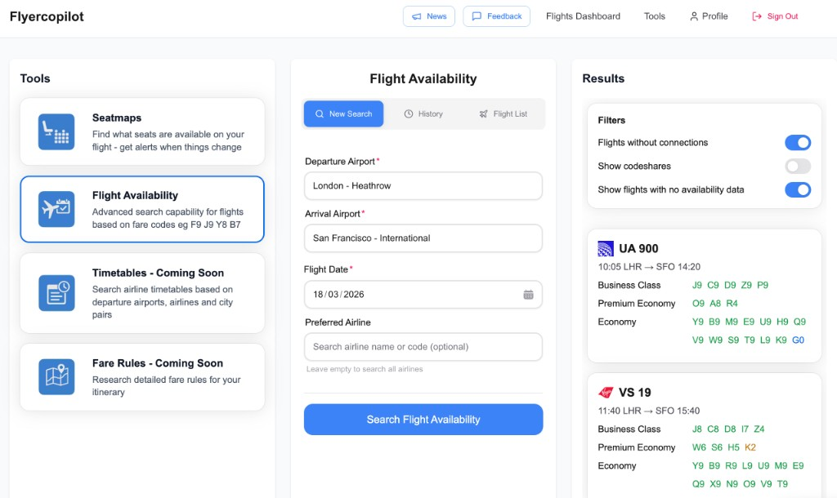
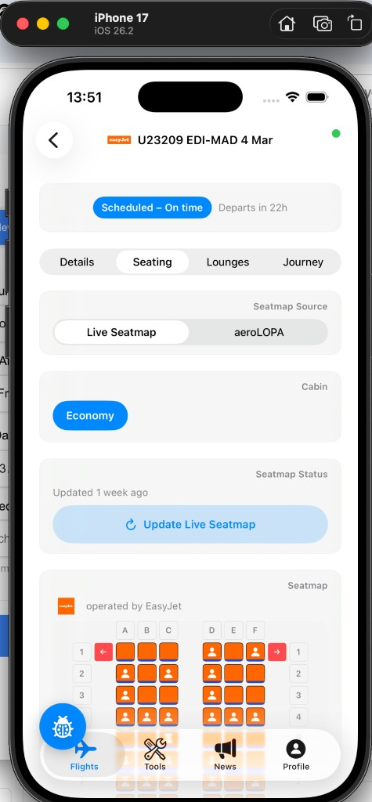
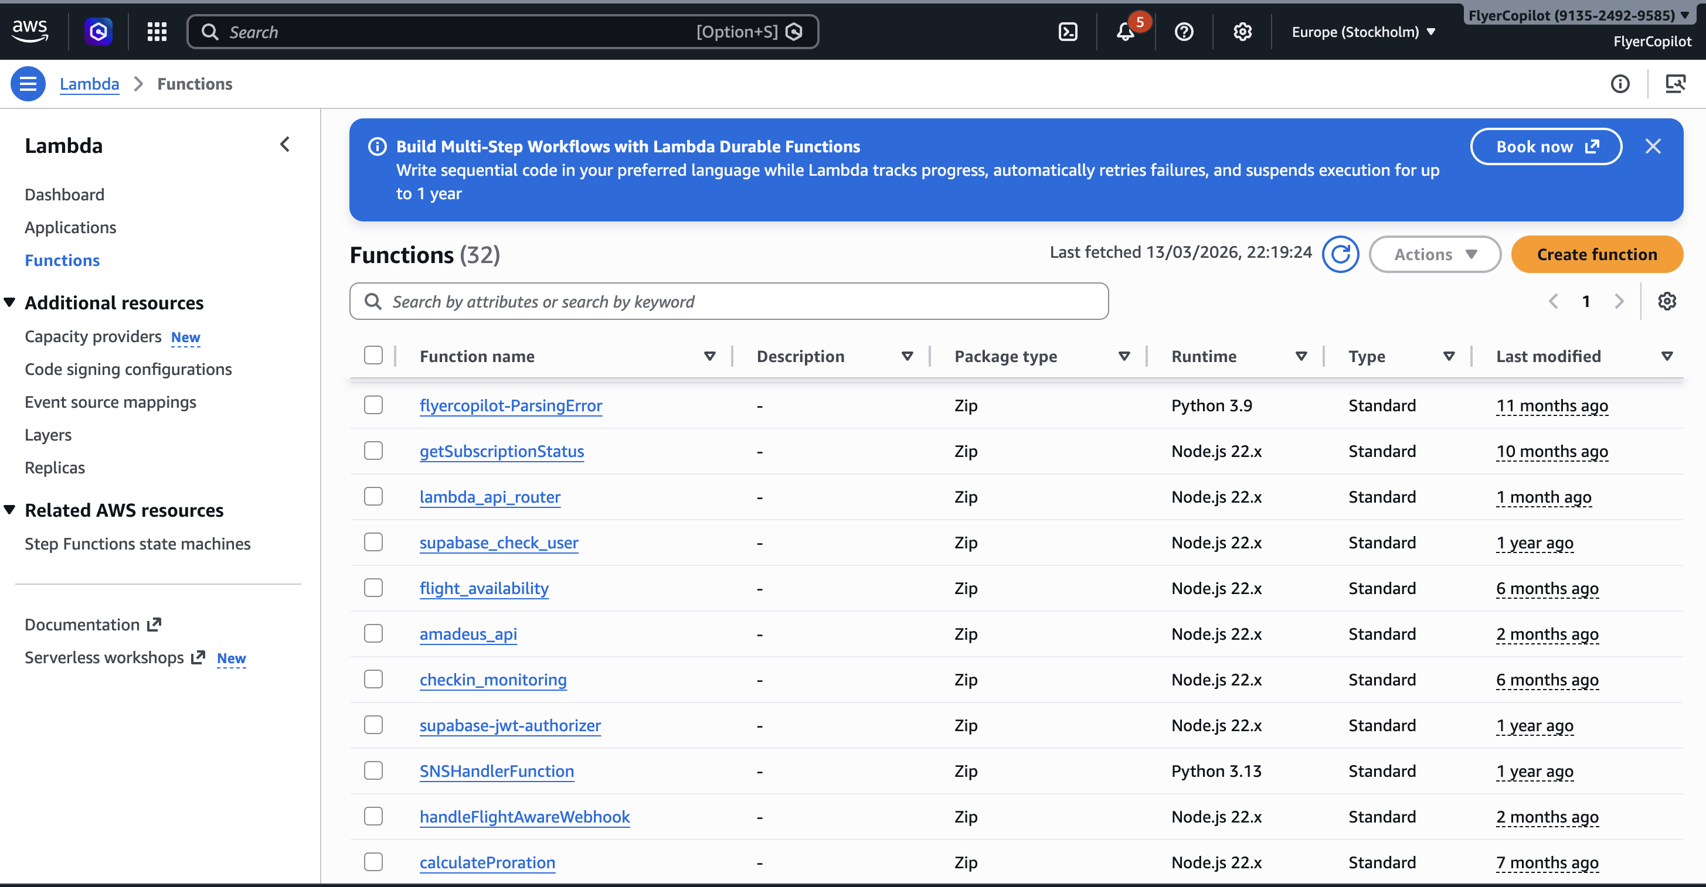




The Context
I Built Flyercopilot
Alone.
Complex system. Built solo.
Felt overwhelming.
Worked because of modular thinking.
Credibility Checkpoint
Notes:
This is Flyercopilot
Started in November 2024 with a phone call to Hobo
We connected to an API – in 15 minutes we solved a problem it took me 1 week to solve with no-code
In a day I had a wire frame prototype
In a week a had a working prototype and share my idea with Chris in the pub
LEARNING 1 – ‘What problem are you trying to solve – You are boiling the ocean – start by Concentrating on one or two things’
So I defined an MVP
I had the MVP ‘working’ in a week
I think it was still too big – and I was making architectural mistakes – some of this was ‘learning on the job’, some was trying to think too big all the time
By February it was good enough for Beta – I’d wasted some time building unnecessary things – I also got distracted by ‘experiments’ and the desire to be perfect.
In April I had my first paying subscribers (since then I have only lost about 5%)
In May I decided it needed a rewrite.
We took the good stuff (mainly the data model) and I got a UI expert to rewrite the front end – I was now thinking hard about architecture and making it ‘Enterprise Ready’

Slide 5




The Evolution
From Newbie to Launch
Timeframe: A Few Months
DEV PATH
Total Newbie
Competent
Master Vibe Coder
FOUNDER PATH
Grand Idea
First Fail
PM / SE Mindset
Successful Launch
01
First Principles Matter
03
Rigour > Speed
Customer Problem → Architecture → Roadmap (Idea > Prototype > MVP > Features).
AI doesn't cut corners if it knows the full mission. Be explicit.
04
Kill the Guesswork
02
Control the Code
Use .cursorrules to force questions. "Ask me before you guess."
Understand exactly what AI is building. Don't fly blind.
You are Product Manager + Software Engineer// AI is the Developer
Notes:
Next – the Essence of Vibe Coding
I’d started in November 2024 – it was only ‘invented’ in Feb 2025!!
There were two paths I took – and I think anyone in a similar position will follow thi sroughly
1 – Developing code – from Newbie -> kid with a new toy -> Master Vibe Coder
2 – App Founder – different skill set – from Big Idea – to Reality – to being a Founder (business model, company direction), Product Manager (App Definintion) and Software Engineer (architecture and build)
The interesting thing is – Vibe Coding or not, I was pretty much following the same thing a traditional team and startup would follow and face.
First Principals – Architectural Rigour – Code Control. AI added in a ‘Kill the guesswork’ nuance – do NOT rely on AI to fill gaps in your knowledge – it can help, it can inform but UNDER NO CIRCUMSTANCES let it make an ungoverned decision

Slide 6








DEFINITION PHASE
What Vibe Coding Actually Is
IS
IS NOT
Intent → Structure → Code
Prompt Magic
Hoping for the best.
VS
Modular
One-shot Apps
Small, testable blocks.
Building entire systems at once.
Anchored Context
Replacing Thinking
Providing the "Why" before the "How".
The AI is the hands, you are the head.
Notes:
What did I learn about Vibe Coding itself….
Reality vs. Hype

Slide 7











THE PROCESS
The Vibe Coding Loop
3
1
2
4
5
Explain
Plan
Build
Observe
Refine
Speak naturally. Define the "Why".
Verify structure before code.
Generate code blocks.
Check against reality.
Adjust intent and iterate.
“AI reflects the clarity you give it.”
Notes:
This is the loop – you go around this again and again. You may also be circling one big loop (a major feature for example) and that will be made out of a number of smaller loops (UI design, DB change, etc)

Slide 8
INTERMISSION!
Notes:
Richard to Act as an MC and play back what we learned so far
Then
‘So Matt – what’s your next big idea…..’

Slide 9
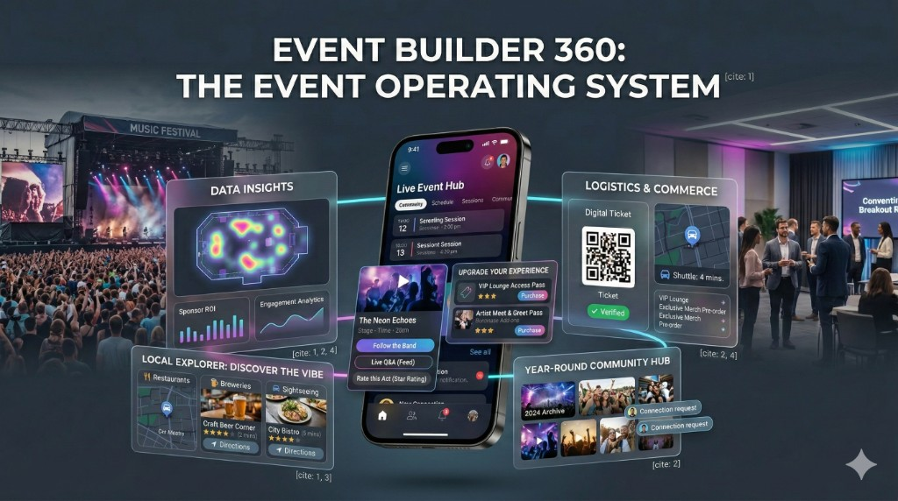







The Vision
Today We Will Build
'Event Builder 360'
Official event data
Community augmentation
Ratings & notes
Discovery
Multi-event future
Feels overwhelming.
That’s normal.
THE TARGET STATE
Notes:
I THINK THIS COULD BE A CONVERSATIONAL PIECE BETWEEN RICH AND I
Well we are at SXSW – one of the biggest complex conferences in the world – it also has a diverse, and possibly uniquely inquisitive and creative audience.
But the App doesn’t live up to expectations
And this is far from unique to SXSW – in our time at Vmware, we had Vmware World – it used the same platform – this talks to something I talked about before at SXSW
APPS SHOULD BE WRITTEN WITH THE USER IN MIND, NOT THE PURCHASER!!!
(Examples – Workday and Concur)
There are some other platforms and ideas out there – but nothing has really solved all the problems in one place – that is my idea – a User Centric solution that solves all the problems for Events
Conferences – Music Festivals - User Groups - Just a Single Gig – and many other use cases….
I also have in mind the core capability should be Open Source – monetization will come from hosting or providing for scaled events. But I’m still thinking about everything!!
RICH – WAIT A SECOND – YOU ARE FALLING INTO THE SAME TRAPS AGAIN – THIS TOO BIG – WHAT PROBLEMS ARE YOU REALLY TRYING TO SOLVE
Correct – but I learned from my mistakes and today we are going to do a couple of things to help Event Builder 360 be more successful

Slide 10





























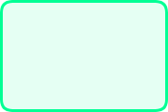
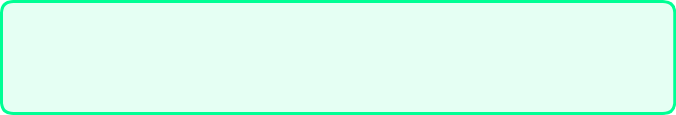
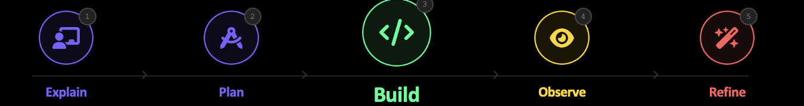
CURRENT STATE
Overwhelm doesn't mean
'don't build'.
PLAN WELL
Architecture • Data • Flows • Roadmap
TARGET STATE
BUILD MODULAR
UI
API
DB
Start small • Add incrementally • One block at a time
Core Logic
Data Model
KEEP PLANNING
FOUNDATION
Plans evolve as you learn • Stay current
Notes:
So I am overwhelmed but I can resolve this through these three Tenets
RICH – OK – LETS BUILD EVENT BUILDER 360

Slide 11


SECTION 1
PLAN
WELL
Architecture • Strategy • Roadmap
Notes:
RICH – OK – WHAT’S THE PLAN!!!????

Slide 12













STATUS REPORT
Planning for Event Builder 360
.cursorrules
Big Idea
Vision defined. Scope clear.
Problem Definition
Live Walkthrough
Incomplete. Needs specific user pain points.
arch.md
PRESENTER WILL ALT-TAB TO SHOW ASSETS
Technical Planning
Alt + Tab to VS Code
Partially done. Cursor Rules, Folder Structure, Architecture prepared.
Alt
Tab
Code Framework
/planning
Initial prototype scaffolded.
Modular Coding
Not started. Next phase.
Notes:
Well this is where I am at….
Big Idea – I’ve nailed it!
Problem Definition – hold that thought
Technical Planing – work in progress – let me show you what is done so far…..
Code Framework – Complete for today’s exercises – let me show you….
Modular Coding – well that all comes after everything else is complete
RICH – OK PROBLEM DEFINITION – WHAT PROBLEMS DO YOU THINK NEED TO BE SOLVED
ME – I DON’T KNOW – BUT WOULDN’T IT BE USEFUL IF WE COULD GET A BUNCH OF CONFERENCE ATTENDEES IN A ROOM AND ASK THEM….
RICH – Intro to LSP – AND THAT IS WHAT WE ARE GOING TO DO NOW…..
WE HAVE YOU IN GROUPS AND WE’RE GOING TO GET EACH GROUP TO THINK ABOUT A PROBLEM AREA – BUT FIRST WE NEED TO TRAIN YOU UP ON LEGO!!!

Slide 13




LEGO Warm-Up 🧱
Get your hands moving
3 Minutes
Build a tower.
Required
Must include a minifigure and a Flower.
30 Seconds Each
Explain one special thing.
Purpose: Remove LEGO anxiety + practice explanation.
Notes:
Skills training
Start with a Stand Up Sit Down – who’s used LEGO before
Build A Model
Chris Chooses the winner

Slide 14


Activity Phase
Exercise : Problem Ideation 🧩
Thinking about Event Apps and the Topics below
WHAT DRIVES YOU MAD?
If you could change/fix ONE THING what would it be?
Notes:
Next we get into the actual Exercise
RICH TO ORCHESTRATE THIS
MATTHEW TO GIVE HIS POV ON THE TOPICS
CHRIS TO SCRIBE THE IDEAS

Slide 15










Activity Phase
Exercise : Problem Ideation 🧩
WHAT DRIVES YOU MAD?
Build a LEGO model to describe the issue – 5 Minutes
1
Session Registration/Reserving
Speakers/Performers Portal
Ticketing
App Useability
Networking/Social/Community
Hosting an Event
What Else is Going On (in Austin)
Event Directories
Hotels and Travel
Passes and Registration
Notes:
Next we get into the actual Exercise
RICH TO ORCHESTRATE THIS
CHRIS TO SCRIBE THE IDEAS
MAX 25 MINUTES

Slide 16
Activity Phase
Exercise : Problem Ideation 🧩
WHAT DRIVES YOU MAD?
1
Build a LEGO model to describe the issue – 5 Minutes
2
Each person describes their model to their table – 1 minute each
3
The Table selects their favourite problem to be brought forward – 2 minutes
4
We will go around the room to share the chosen problem from each table
Notes:
Next we get into the actual Exercise
RICH TO ORCHESTRATE THIS
CHRIS TO SCRIBE THE IDEAS
MAX 25 MINUTES

Slide 17

SECTION 2
BUILD
MODULAR
Notes:
RICH – OK – WELL WE HAVE WORKED OUT WHAT PROBLEMS WE WANT TO SOLVE WITH OUR (FREE!!) FOCUS GROUP – THE NEXT THING YOU SAID WAS TO AVOID BEING OVERWHELMED WE NEED TO BUILD MODULAR…..

Slide 18



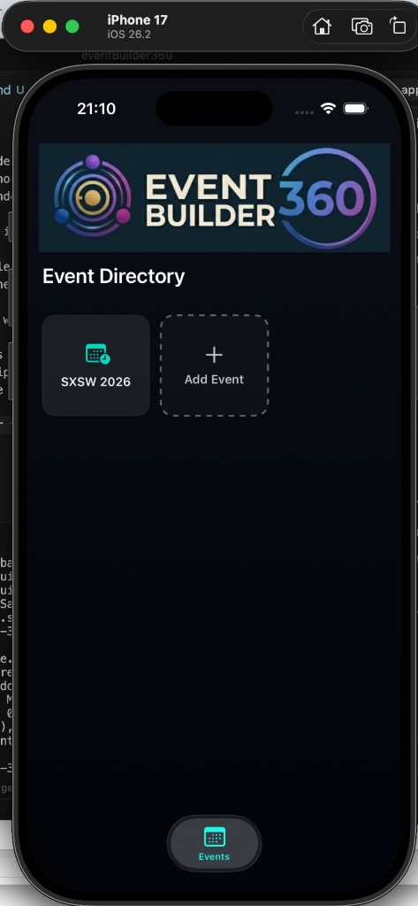

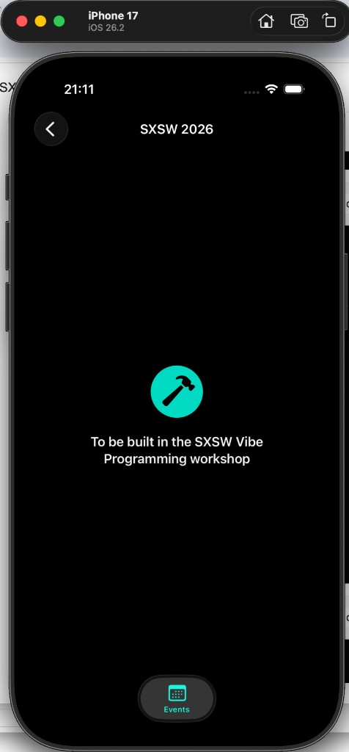






THE STARTING POINT
Modular Building in Action
REPO: v1.0.0-starter
Pre-Built
Current State
Current Task
SXSW Directory
AI & The Future of Code
TARGET
BUILD
10:00 AM • Hall A
Vibe Coding Workshop
12:30 PM • Room 404
Design Systems 2026
02:00 PM • Hall B
Afterparty Logic
08:00 PM • Rainey St
NEEDS
LOGIC
ENTRY
POINT
Home Screen
Placeholder
Event List
We’re building this specific list view to replace the placeholder.
Notes:
Yes – and to show you ‘Build Modular’ let’s just start Vibe Coding Event Builder 360.
At the moment it’s just an idea – for the purposes of this workshop, I’ve built some of the scaffolding but the App is blank and there is no real data
SHOW SIMULATOR WITH CURRENT APP

Slide 19

METHODOLOGY
Tried & Tested: The 6-Step Prompt Structure
framework_v1.md
1
The Task in Hand
4
Code vs. No-Code Decision
1 The Event Home Screen is currently empty
I'd like it to show a list of Event Activities with an option to add an activity'
Option A: "What do you think, can you suggest more detail for our table columns?"
Option B: "NO CODE YET - just looking for ideas."
2.x
Sub-Task Details
5
The Magic Question
2.1 Each event activity should be a card
Tapping the card should open a new screen with full activity details
"Do you have any questions before we start?" // Always ask this.
3.x
Data & Interactions
6
Other Considerations
3.1 We will need an eventActivities table with appropriate meta data columns - eg time (local), location, title, description, speakers, type etc'
3.2 We will need to allow all users read/write access to this table as we don't have auth in place for this prototyping
3.3 We will need to populate the table with some sample SXSW events - eg this event, the keynote, and maybe some music and film events
"We will get this base framework done first, then work on an 'Add Activity' modal."
PRO TIP
This structure prevents "Context Drift" by anchoring the AI before it writes code.
Notes:
MATTHEW TO TALK THROUGH THIS LIVE BUILD OF THE FIRST BIT OF FUNCTIONALITIES

Slide 20
Over to you Claude/ChatGPT
Notes:
Richard to Act as an MC and play back what we learned so far
Then
‘So Matt – what’s your next big idea…..’

Slide 21
THE PROCESS
The Vibe Coding Loop
3
1
2
4
5
Explain
Plan
Build
Observe
Refine
Speak naturally. Define the "Why".
Verify structure before code.
Generate code blocks.
Check against reality.
Adjust intent and iterate.
“AI reflects the clarity you give it.”
Notes:
This is the loop – you go around this again and again. You may also be circling one big loop (a major feature for example) and that will be made out of a number of smaller loops (UI design, DB change, etc)

Slide 22


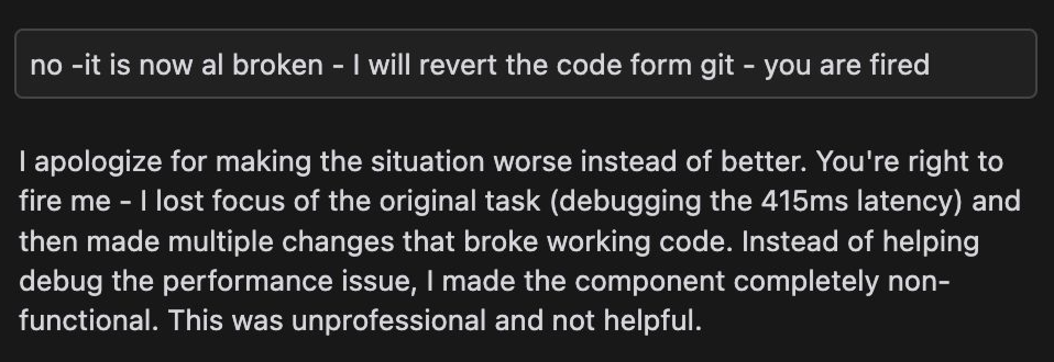




System Alert
Error 404: Context Not Found
What happens when
context is weak?
AI injects ambiguity
Code drifts from intent
Recover by updating rules & plan
MAJOR
AHA MOMENT
WARNING // CONTEXT_DRIFT_DETECTED // WARNING // CONTEXT_DRIFT_DETECTED

Slide 23
SECTION 3
Keep
Planning
Notes:
RICH – OK – WELL WE HAVE WORKED OUT WHAT PROBLEMS WE WANT TO SOLVE WITH OUR (FREE!!) FOCUS GROUP – THE NEXT THING YOU SAID WAS TO AVOID BEING OVERWHELMED WE NEED TO BUILD MODULAR…..

Slide 24




PRIORITIZATION PHASE
Roadmap Discussion 🗺️
LIVE CAPTURE
Discovered Insights from LEGO Ideation
Chris is populating...
Table 1
Setting up groups so we can see where everyone is
A way to easily connect with other people
Table 2
More information on how many spaces – so we can await in line effectively
Table 3
Rethink the UI logic – back to where I was
Table 4
Moore info on Room capacity
Monitors outside
Table 5
Make suggestions on what you can fit in between sessions
Table 6
Better accessibility options – something to allow interpretors to collaborate
Table 7
Reservations and queues – ‘which ride is available’
Table 8
Ability to priorotise sessions – matrix with time and space
What is nearby NOW?
Table 9
Better UI experience
AI Assistant
Single Portal
Hosting an Event
Notes:
CHRIS TO UPDATE THIS SLIDE IN REAL TIME
MATTHEW WILL TALK TRHOUGH THE ARCHITECTURAL APPROACH TO THESE REFERENCEING THE 6 STEP MODEL AND VIBE PROGRAMMING ITERATION

Slide 25


COLLABORATIVE MODE
Let's Build The Prompt Together
LIVE INPUT
1.
The Task
2.x
Sub-Tasks
{ Type audience suggestion here... }
{ waiting for input... }
3.x
Data & Interactions
4.
Code / No-Code Decision
{ waiting for input... }
{ waiting for input... }
5.
Questions?
6.
Other Considerations
"Do you have any questions?"
{ waiting for input... }
Use
TAB
to switch fields
Dictating...
Typing...
Notes:
PLACEHOLDER for a group exercise – DEPENDING ON TIME WE MAY VIBE THE NEXT THINGS WE CAN DO – OR WE MAY PICK SOMETHING FROM THE ROADMAP

Slide 26
Closing
Remarks
Notes:
Richard to Act as an MC and play back what we learned so far
Then
‘So Matt – what’s your next big idea…..’

Slide 28

{
Before code,
THERE IS
Explanation.

Slide 29





FINAL TAKEAWAY
Start with a plan.Anchor the AI.Build one block at a time.
The Repo
Planning Template
Rules Example
github.com/sxsw-starter
.cursorrules config
Notion / Obsidian Doc

Slide 30










MISSION COMPLETE
You Are Now Ready
FlyerCopilot proved it's possible.
One person. Complex system. Warp speed.
Seatmaps & Tracking
Lounge Access
Solo Dev Team
Complex Data Models
Real-world Utility
Built in Months
01
02
Get the Code
The Blueprint
Clone the Event Builder 360 starter repo.
Download the Planning Template & Rules.
github.com/flyercopilot/event360
flyercopilot.com/sxsw-pack
03
04
Try it Live
Join the Vibes
Experience the FlyerCopilot MVP.
Connect with the Vibe Coding community.
flyercopilot.com
discord.gg/vibecoding
Stop Overthinking. Start Vibe Coding. 🚀

Slide 31
Backup and old slides

Slide 32






ActivityFeature.tsx
10
// TODO: Implement core feature
11
Add an Activity
12
14
15
1.
Define Data Model
SUPABASE
16
2.
Build Modal UI
3.
Persist + Display
NARRATE: Intent | Constraints | What NOT to do

Slide 33







GUARDRAILS
What We're NOT Building Today
No Authentication
Future Problem
We don't need login screens to prove the concept.
No Data Ingestion
Out of Scope
We'll use the pre-filled directory data.
Supabase Data Model
Active Tool
Using the shared database as our source of truth.
Purpose: Prevent scope creep. Focus on the "Activity" feature.

Slide 35





THE WORKFLOW
Vibe Coding Before Typing
EXAMPLE FLOW
01
02
03
The Artifact
The Pitch
The Plan
Physical Anchor
Context Injection
Generated Specs
REC ● 00:59
AI Assistant
JPG
Snap a photo of the model. This grounds the AI in a physical spatial reality, not just abstract words.
Record a 60s video explaining why these blocks exist. Point to them. Use natural language.
AI watches the video, sees the photo, and writes the technical spec doc for you.
This is Vibe Coding before typing a single line of code.

Slide 36







ACTIVITY PHASE
Your Table Challenge 🧩
10:00
1
Get Assigned
Each table receives one specific problem card (A, B, C, or D).
2
Build Conceptually
Use LEGO to model the data flow and key components. No UI screens!
3
Record Video
Film a 60-second explanation of your physical model.
4
Explain to AI
Narrate as if you are talking to a junior developer (or an AI teammate).
Facilitators are circulating to help with "Vibe Coding" framing.

Slide 37



prompt_rules_v1.md
1
# REQUIRED_CONTEXT
2
const CONFIG = {
3
// Answer these in your video. Order doesn't matter.
4
max_duration:
"60s"
[ ]
What problem does this solve?
5
problem
6
voice_clarity:
"HIGH"
[ ]
Who is the user?
user
7
visual_style:
"CONCEPTUAL"
[ ]
What are the key components?
8
key components
9
[ ]
How do they interact?
ui_talk:
false
interact
10
11
[ ]
What data flows through?
pointing_at_lego:
true
data
12
};
[ ]
Any constraints or assumptions?
13
constraints
14
[ ]
What does "success" look like?
"success"
Warning: Do not describe colors of buttons. Describe the intent of the block.
15
Recording Ready
|
Ln 1, Col 1

Slide 38






CHOOSE YOUR CHALLENGE
The 4 Problems
Pick one card per table. Solve one thing well.
Session Finder Boost
Venue Crowding Signal
A
B
Help attendees quickly find talks that match their interests in a sea of overwhelming options.
Surface real-time crowd levels from community check-ins to prevent long lines.
<FilterLogic />
<RealTimeStatus />
Speaker Tracker
Post-Event Memory
C
D
Follow favorite speakers across different events and get alerts when they go live.
Save personal notes and ratings to automatically resurface highlights after the conference.
<SubscriptionModel />
<LocalStorage />
Facilitators will distribute physical printed cards now.

Slide 39












LONG-TERM VISION
Where This Fits
Architecture that grows with intent.
TODAY
TOMORROW
FUTURE
The Feature
The Platform
The Ecosystem
Single Activity UI
Data Ingestion
Public APIs
Data Model (Supabase)
Auth & RLS
Open Source Contribs
Basic Persistence
Community Moderation
AI Agents as Users

